Slide 1
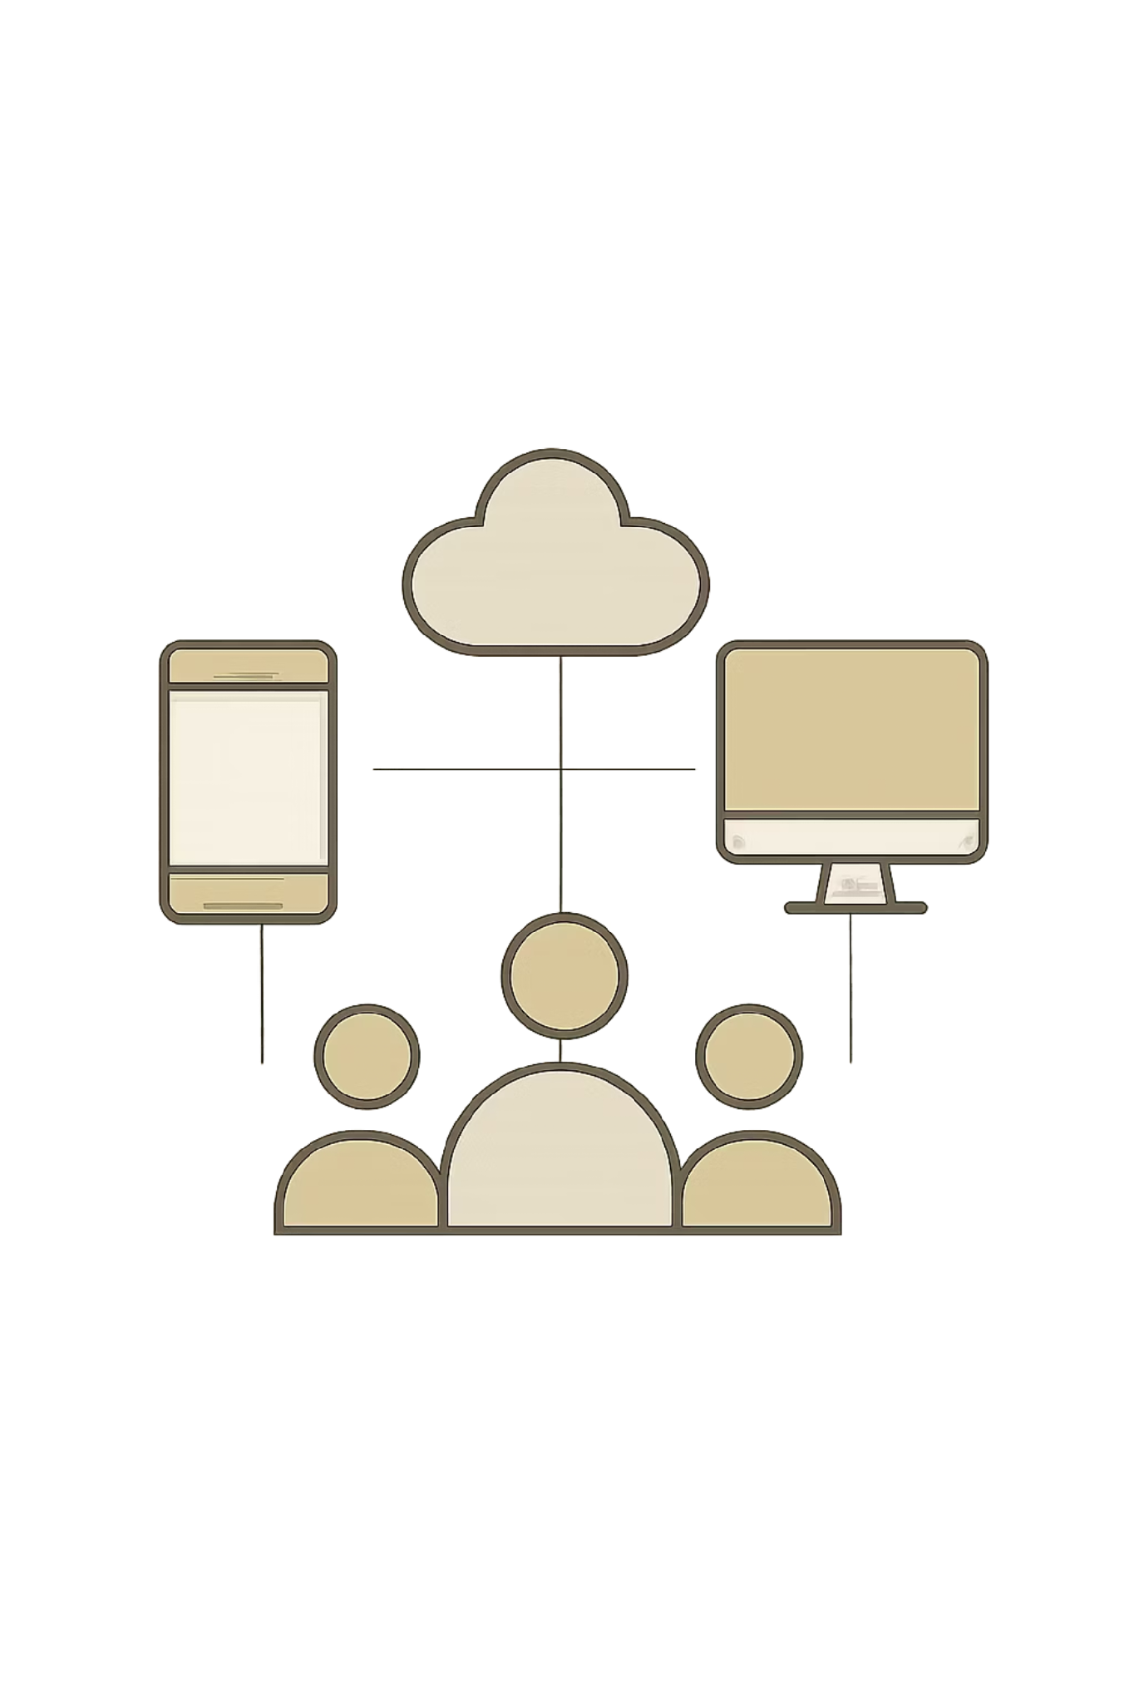
Skill Sharing and Volunteer Exchange
Bridging the Digital Gap Through Digital Literacy, Skill Sharing and Technology Intervention
Community Engagement Project (CEP) · TYBSc Computer Science
Students:
26TCS03 - Harsh Salvi
26TCS11 - Farhan Shaikh
26TCS21 - Ashif Shaikh
26TCS27 - Sachin Jaiswal
26TCS37 - Arshad Shaikh
Our CEP focused on understanding the digital and technological needs of NGO employees and developing a practical intervention through digital-skills training, learning resources, practical sessions and a web application.

Slide 2
What We Wanted to Achieve
01
02
03
Understand the NGO's working environment
Understand employee roles and responsibilities
Study current technology usage
04
05
06
Identify technology-related difficulties
Understand employees' learning requirements
Provide practical digital-skills training
07
Support better adoption of workplace technology
Initial Interaction — 2 September
Employee Engagement — 9 September
Formal introduction
Project objectives
Understanding the organization’s work
Interaction with available staff
One-to-one discussions
Technology gaps and available devices

Slide 3
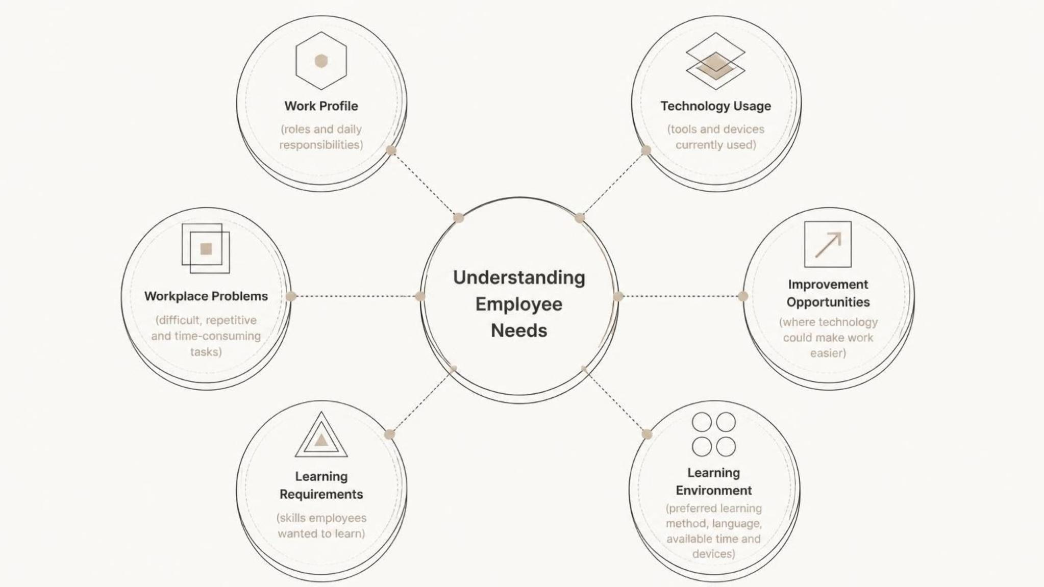
Understanding the Employees Before Designing the Solution
We conducted a structured workplace technology survey to understand employee needs before deciding which technology to teach.
"We first studied the employees' actual needs instead of assuming which technology they needed."

Slide 4





Key Findings
Limited Digital Literacy
Hardware & Software Knowledge Gap
No Structured Training Program
Many employees had limited familiarity with computers and modern digital tools.
There was no systematic digital-skills training program.
Employees required better understanding of basic hardware and software concepts.
Existing Resources Were Underutilized
Difficulty Using Existing Web Application
Available technology was not always being used effectively because of limited experience and knowledge.
The organization had an ERP/web application, but its complexity made it difficult for employees to use effectively.
"Technology was available — but effective technology adoption was limited."

Slide 5
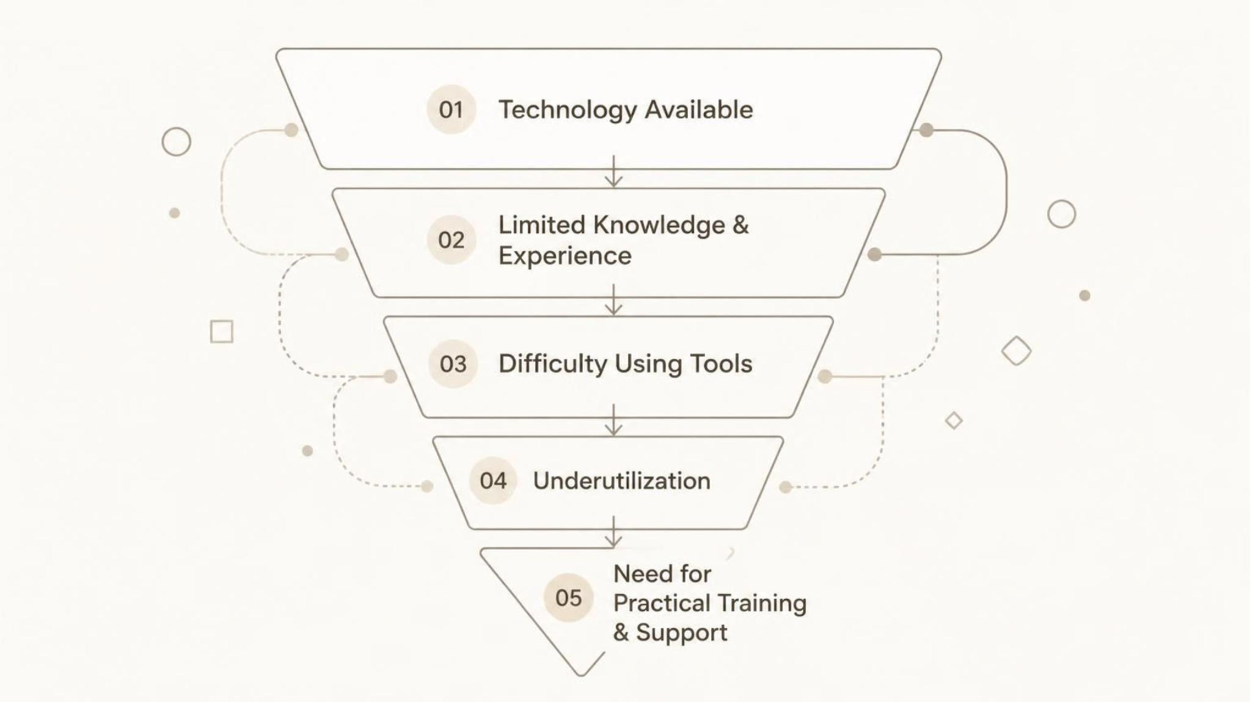
The Digital Gap
"The challenge was not simply the absence of technology. It was the gap between available technology and the employees' ability to use it effectively."
Our Response We decided to address both sides:
People → Digital Skills
Technology → Digital Intervention

Slide 6
NGO Digital Skills Training Program
6 Levels | 18 Chapters | ~20 Core Hours
1
Level 1: Computer & File Basics
2
Level 2: Documents & Reports
3
Level 3: Excel
4
Level 4: Email & Google Drive
5
Level 5: PowerPoint, PDF & Internet Safety
6
Level 6: Real NGO Workflow & Final Test
"Start with basic digital literacy → progress toward real workplace independence."

Slide 7

Practical Training Methodology
Training was designed around hands-on practice.
Resources Created
Structured training modules
Video guides
Practical exercises
Step-by-step demonstrations
Guided Practice
Independent Practice
Practice with instructor support and feedback.
Apply skills solo to build confidence.
Practical Skills Included
File management
Document/report creation
Excel and spreadsheets
Email and attachments
Google Drive
Internet and digital safety
Demonstration
Real Workplace Task
Show step-by-step procedures with examples.
Perform authentic tasks in the workplace.
"The objective was not simply to teach software, but to make employees more comfortable performing real digital workplace tasks."

Slide 8
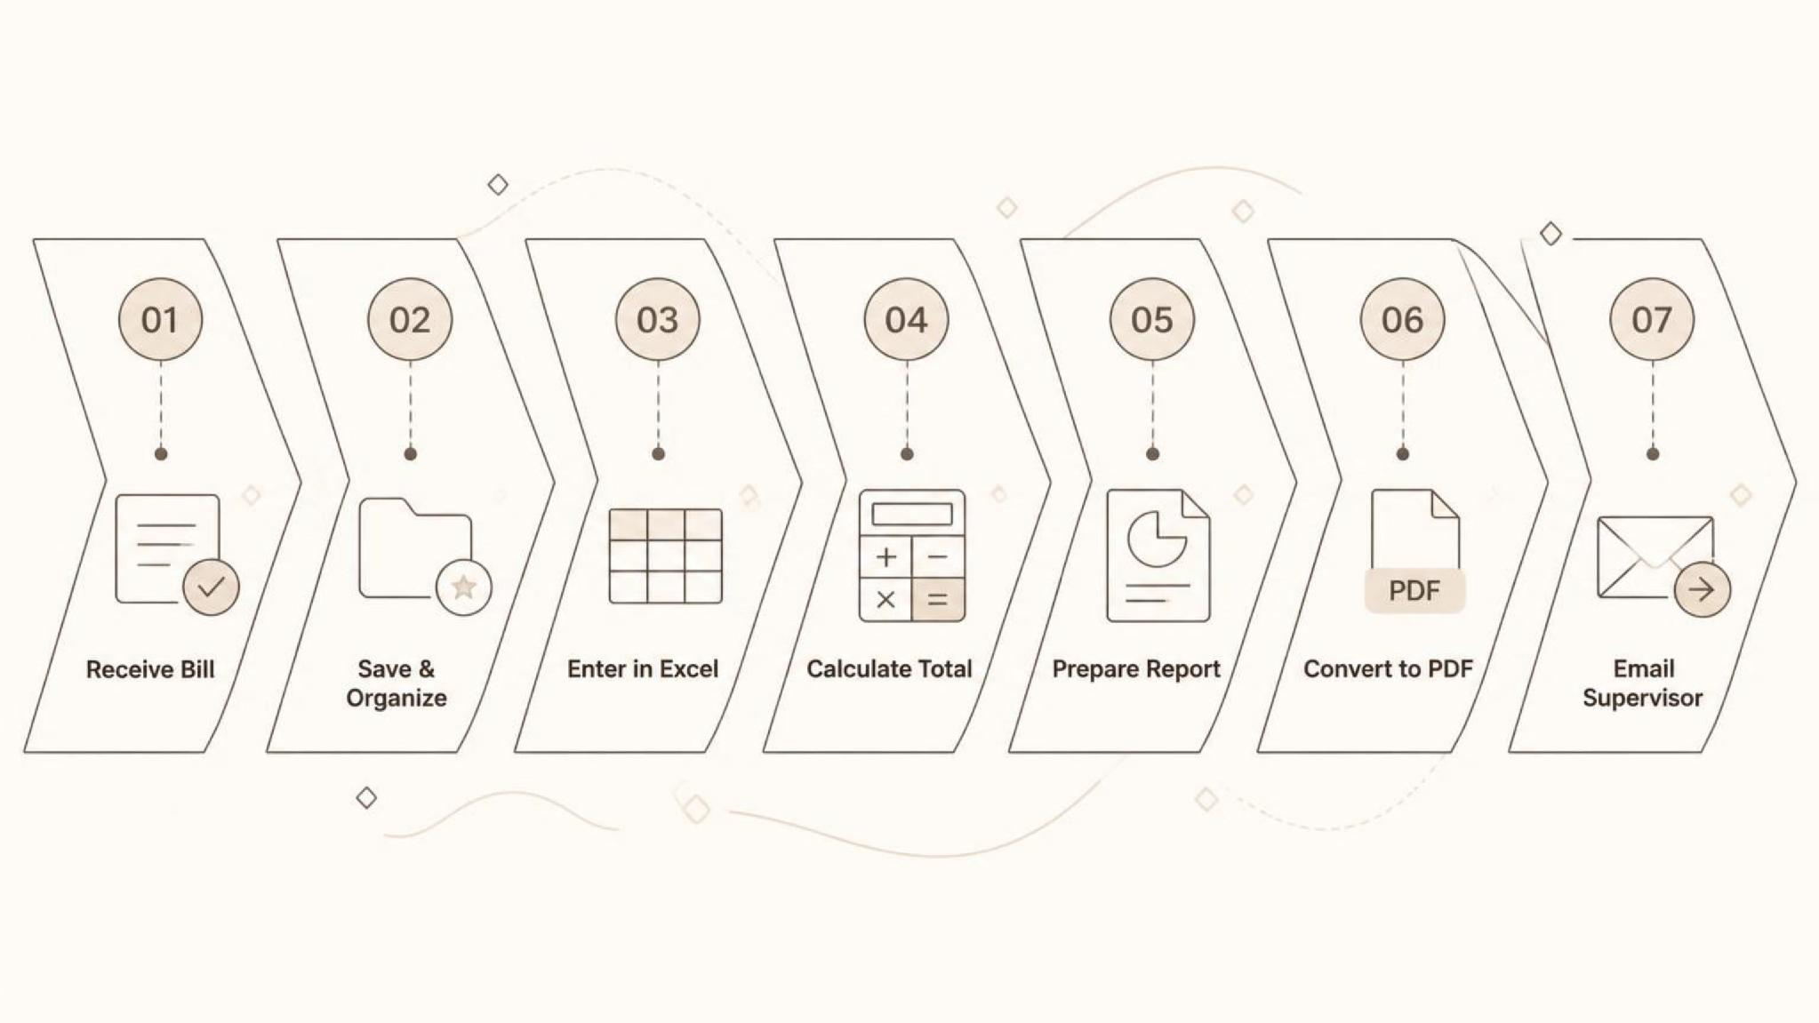
From Training to Workplace Application
In-office sessions were conducted with employees. During these sessions we:
Taught digital concepts
Demonstrated tools
Provided hands-on practice
Addressed individual difficulties
Demonstrated the organization's web
application
Example Real-World Workflow
"This demonstrates how multiple individual digital skills can be combined into one realistic workplace task."

Slide 9

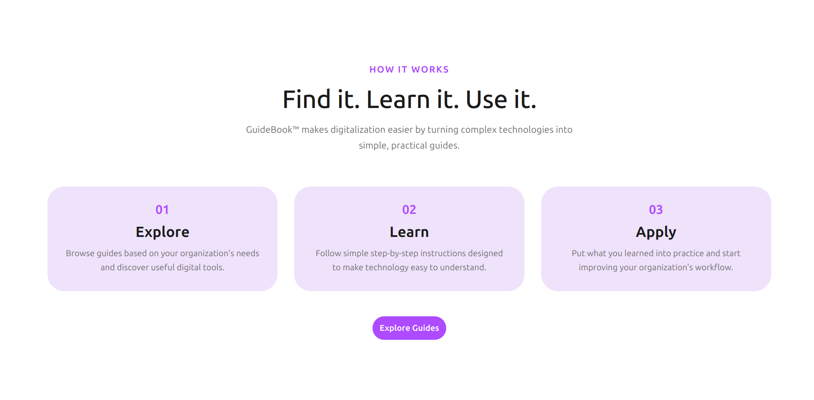
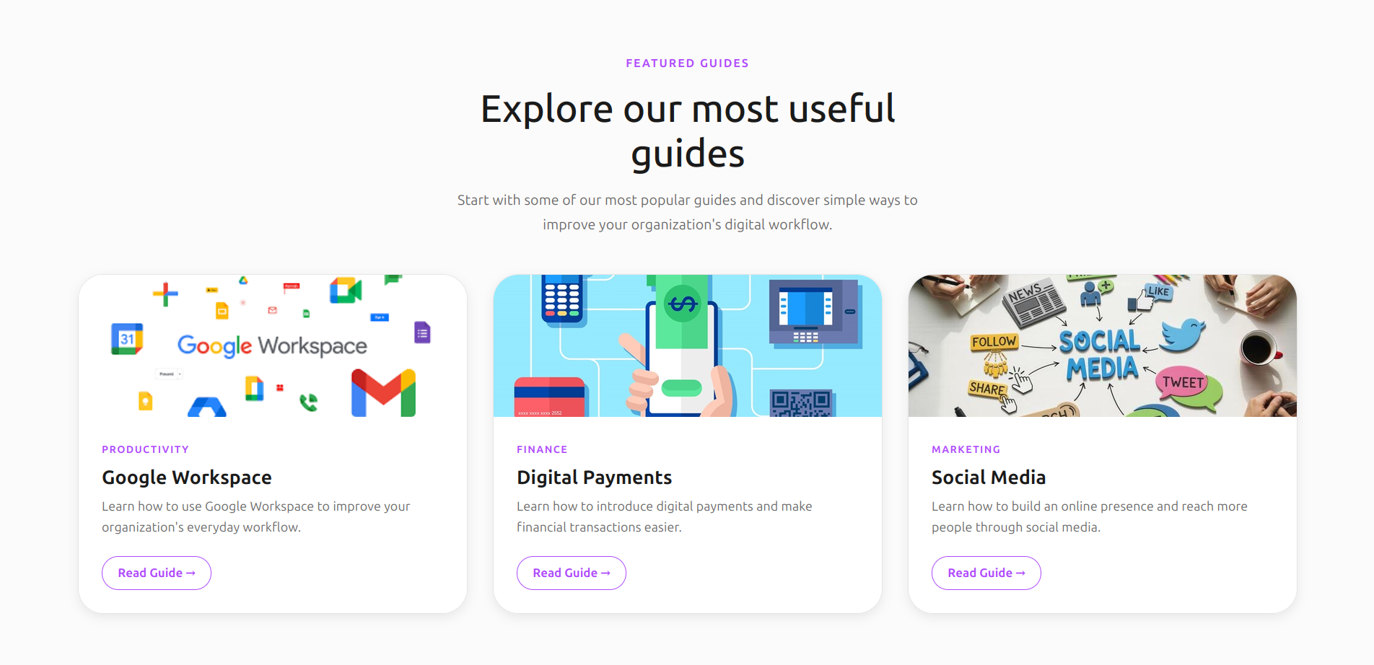
Web Application & Project Outcomes
As part of the project, our team also created a web application to contribute toward the organization's digital workflow.
Project Outcomes
NGO
Employees
Student Team
Structured training resources
Digital-skills material
Technology adoption support
Exposure to digital workplace skills
Practical experience with common tools
Better awareness of digital workflows
User requirement analysis
Community interaction
Training design
Technology development experience

Slide 10



Conclusion
"Our CEP project demonstrated that providing technology alone is not enough. Effective technology adoption requires understanding users, identifying their actual difficulties and providing them with the knowledge and confidence required to use technology effectively."
Key Learning
1
Understand Before You Build
2
Technology Must Be Usable
Real user requirements should guide the solution.
A technically available system is not useful if users cannot comfortably operate it.
3
Practical Training Matters
4
Community Engagement Is Two-Way
Hands-on workplace examples are more meaningful than purely theoretical instruction.
We contributed our technical knowledge while gaining real-world experience in communication, requirement analysis and problem solving.
UNDERSTAND
EMPOWER
ENABLE

